Slide 1

Maester
Your Microsoft 365 test automation framework
Merill Fernando
@merill
1 / 15

Slide 2
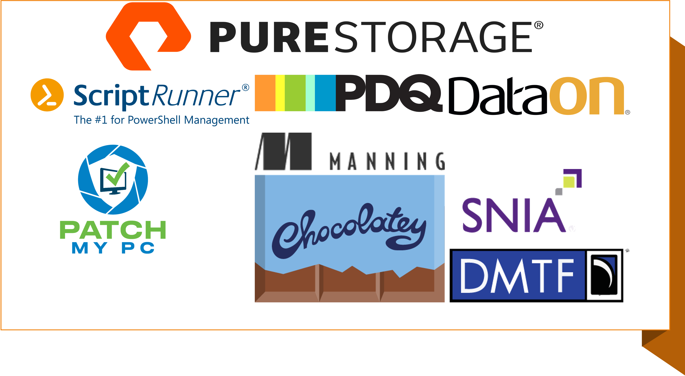
Keep this here and replace it with the update sponsor image that will be sent out the week prior to summit

Slide 3
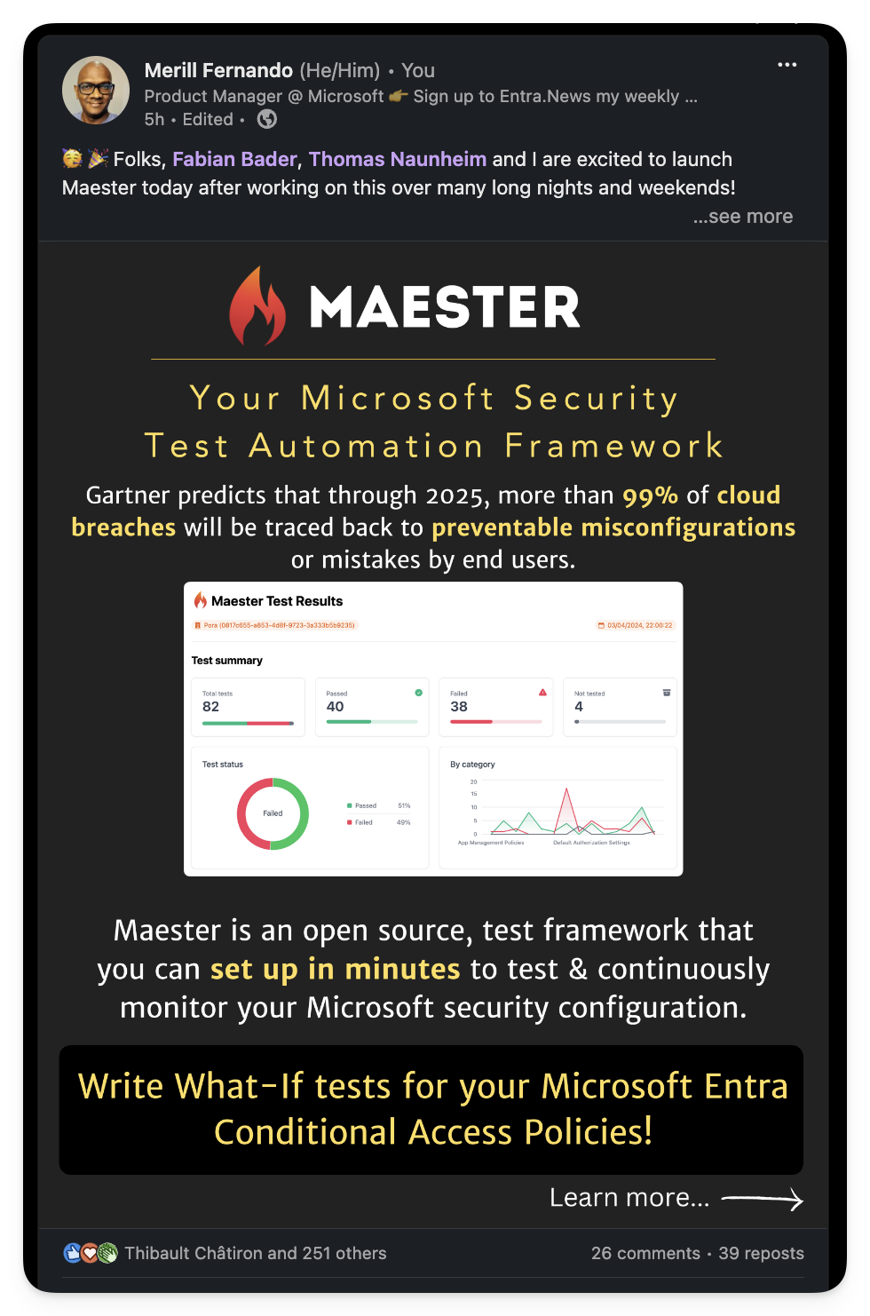
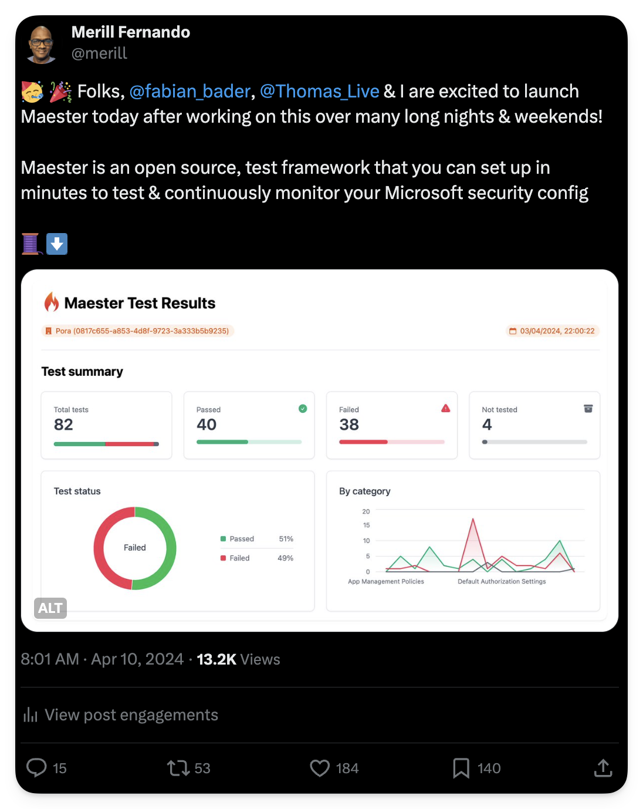
Notes:
https://venturebeat.com/business/takeaways-from-gartners-2021-hype-cycle-for-cloud-security-report/

Slide 4
Gartner predicts that through 2025, more than 99% of cloud breaches will be traced back to preventable misconfigurations or mistakes by end users.
https://venturebeat.com/business/takeaways-from-gartners-2021-hype-cycle-for-cloud-security-report/
Notes:
https://venturebeat.com/business/takeaways-from-gartners-2021-hype-cycle-for-cloud-security-report/

Slide 5
Insecure configuration of identity platform
Misconfigurations and exposure of identity platforms and their components are common vectors for attackers to gain unauthorized high-privilege access.
Microsoft Digital Defense Report 2023
aka.ms/mddr
Notes:
aka.ms/mddr

Slide 6
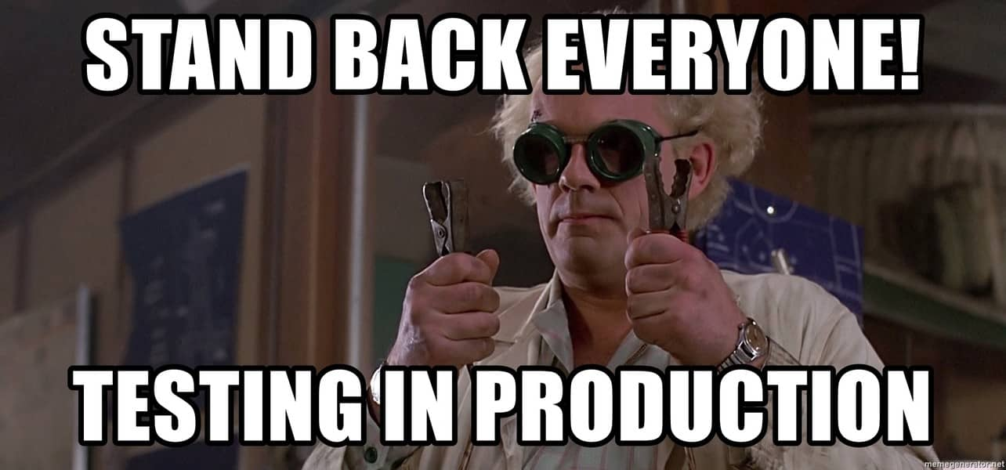
Notes:
Unfortunately, this is how most Microsoft 365 tenants are administered in production today.
At least in this meme they are doing some form of testing.
Let me tell you about a customer that had a conditional access policy enforcing MFA for their guest users. Somebody was doing a clean up and removed all the users from this group AND NOBODY NOTICED IT FOR A YEAR!!!
How confident are you that your environment doesn’t have this issue or a variation of this?

Slide 7
Notes:
Okay maybe not the speed (when you start) but over time the tests will help you.

Slide 8
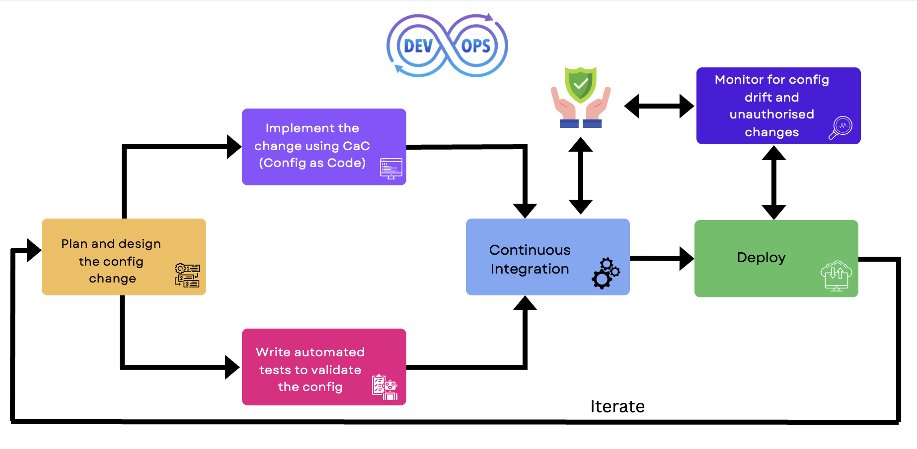
Maester
Maester
Notes:
Use this to explain Maester’s place in the DevOps lifecycle .

Slide 9
The Demo
Running Maester

Slide 10
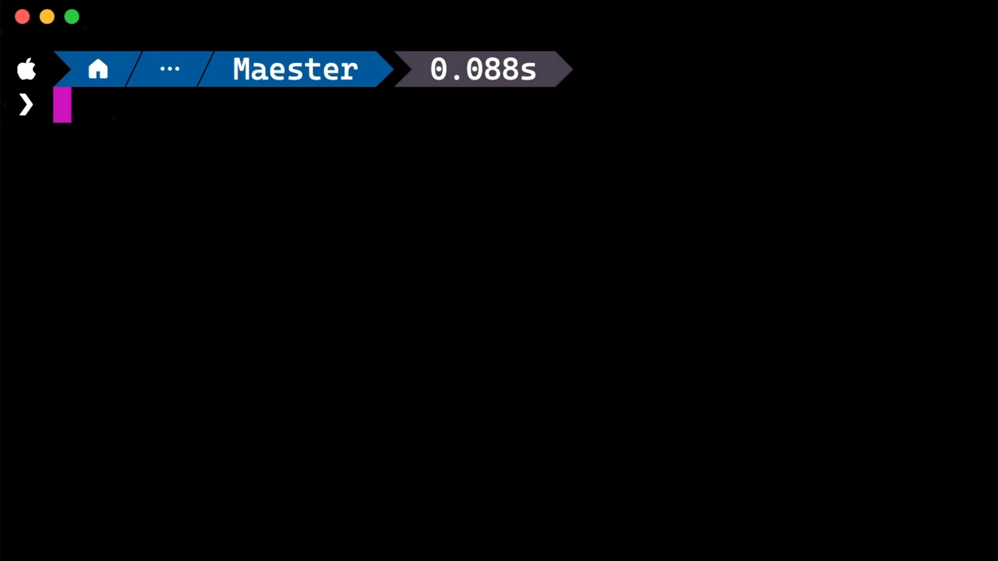

Slide 11
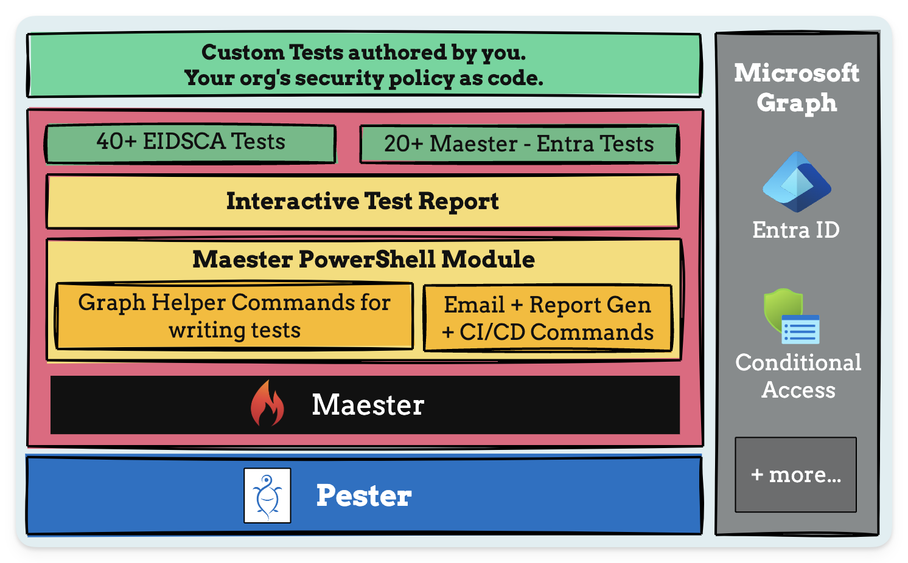
Maester Framework
Notes:
https://venturebeat.com/business/takeaways-from-gartners-2021-hype-cycle-for-cloud-security-report/

Slide 12
Quiz: Who can remember the Maesters?

Slide 13

Notes:
Yes

Slide 14
Isn’t this just Pester? Why do I need Maester?
You are right, you don’t need Maester.
You could have always written these tests with Pester.
Notes:
Show the out of the box tests as well as the documentation for Maester

Slide 15
Why Maester?
With Maester we want to make Pester approachable to more IT admins and cybersecurity teams.
PS. Have you seen the Pester test results 😱?
We spent time improving the test results,
Easy navigation with deep links to the Microsoft Admin portals
Step by step, simple guides for CI/CD pipelines
Notes:
Show the out of the box tests as well as the documentation for Maester

Slide 16
Out of the box tests
Entra ID Security Config Analyzer (EIDSCA) tests
Maester tests
Conditional Access - What If tests
Custom tests
Notes:
Show the out of the box tests as well as the documentation for Maester

Slide 17
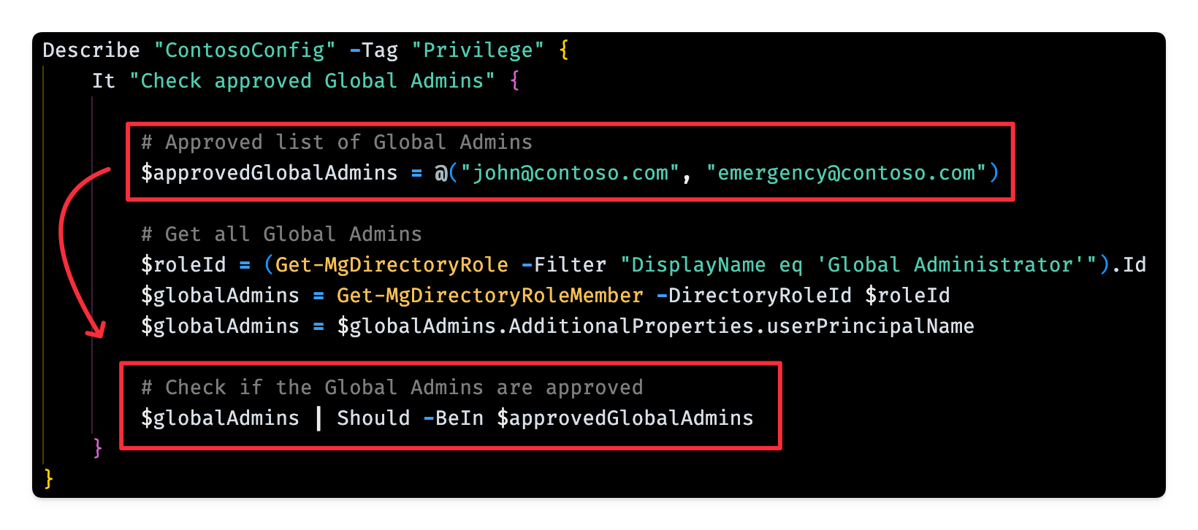
Writing custom tests

Slide 18
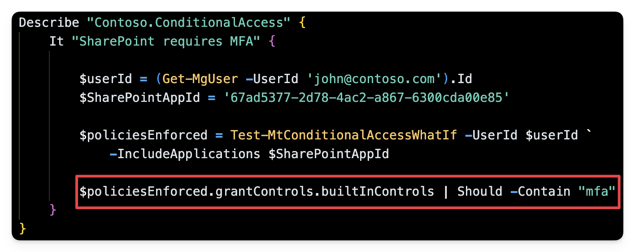
Conditional access - What If Tests

Slide 19
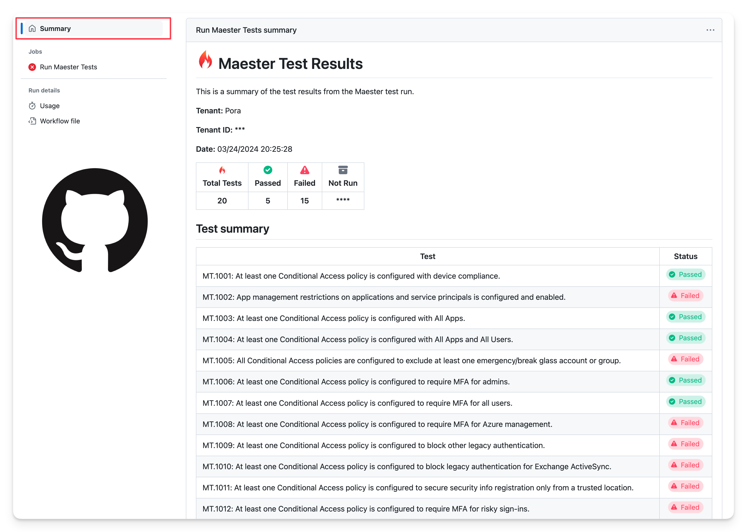
GitHub and Azure DevOps Integration
Notes:
Demo setting up automation with workload identity federation

Slide 20
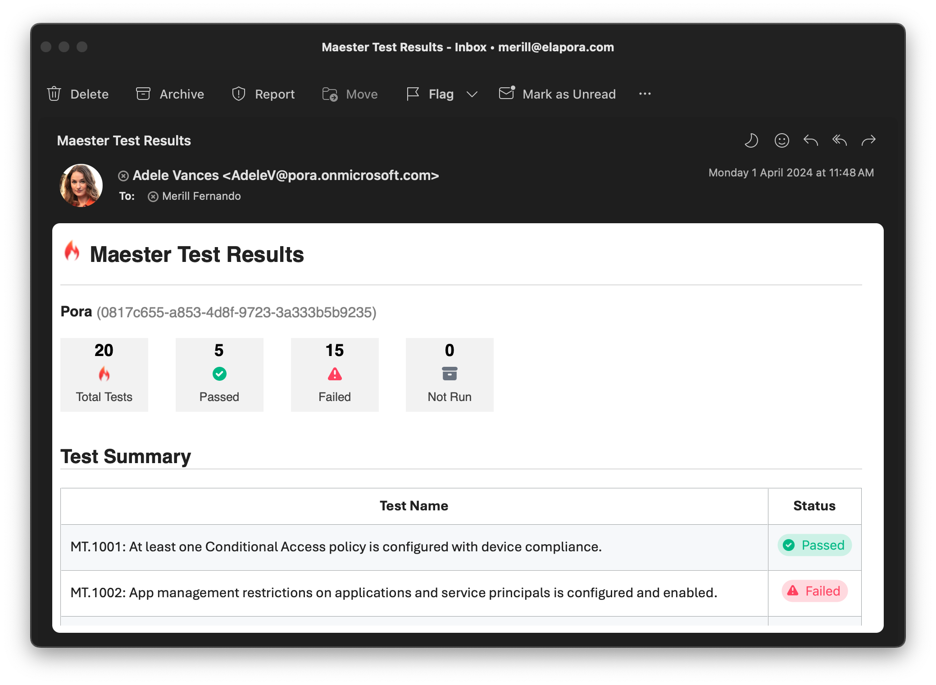
Maester Email Alerts
Notes:
Show demo running from command line

Slide 21
Found a security configuration issue?
How do you keep it from happening again in the future?
Write a test in Maester! Of course.
Build this out over time and you will have your organization’s security configuration as code.
Notes:
Show the out of the box tests as well as the documentation for Maester

Slide 22



The Maester Core Team
Fabian Bader
Microsoft MVP
@fabian_bader
Thomas Naunheim
Microsoft MVP
@Thomas_Live
Merill Fernando
Microsoft PM
@merill
Notes:
Show the out of the box tests as well as the documentation for Maester

Slide 23
Many thinks to all the folks who helped test, review and the giant shoulders we are standing on…
Clayton Tiger
Friedrich Weinmann (PSFramework, PSModuleDevelopment)
Justin Grote
Andrew Taylor
Kristy Chromicky
Shehan Perera
Pester team! 🙌
PlatyPS team! 🙏
Alt3/Docusaurus.PowerShell 👏
Notes:
Show the out of the box tests as well as the documentation for Maester

Slide 24

THANK YOU
Please review this session

